Slide 1


An Overview of Quality Assurance in
Turkish Higher Education System
Prof. Dr. Yusuf Ziya Erdil
December 2017

Slide 2

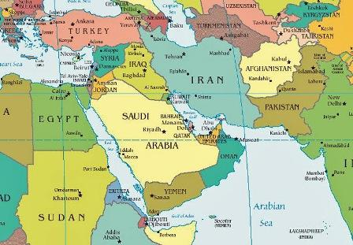
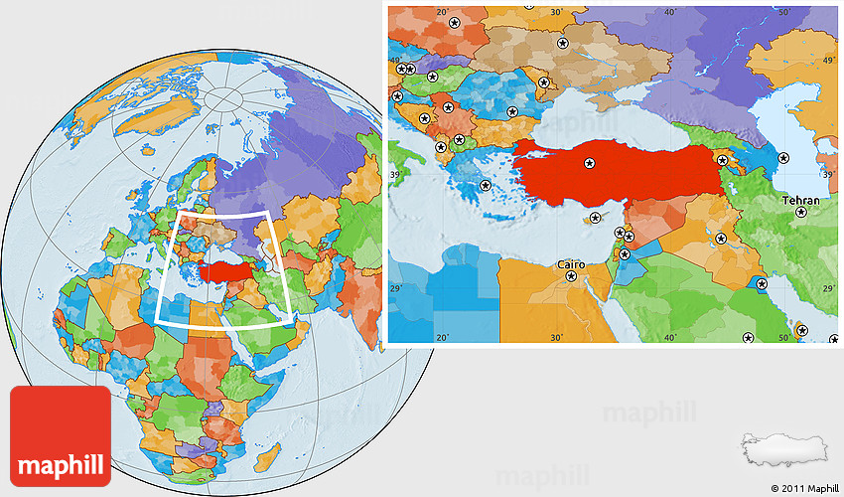

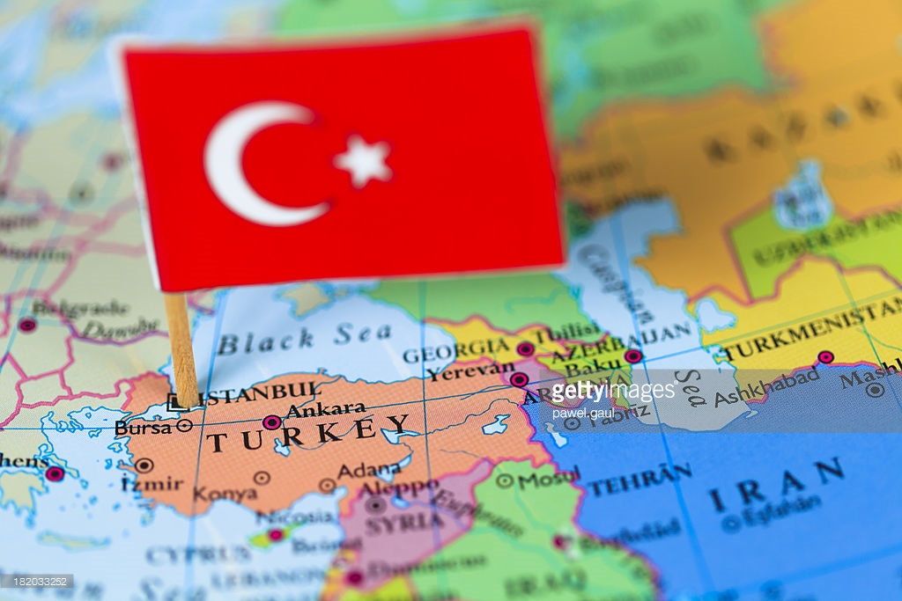
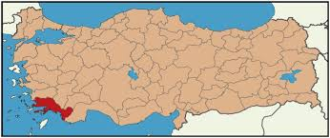
MUĞLA - TÜRKİYE
Notes:
Muğla ili
Türkiye’nin güney batı köşesinde Ege Denizi ve Akdeniz’in buluşma noktasında yer almakta olan Muğla ili Gökova, Bodrum, Marmaris, Datça, Milas, Dalyan ve Fethiye gibi tanınmış birçok tatil merkezine ev sahipliği yapmaktadır. Güzel tatil beldeleri, geçmiş medeniyetlere ait etkileyici ören yerleri, muhteşem manzaraları, büyük plajları termal suları, zengin flora ve faunasının yanında her zevke uygun restoran ve eğlence seçenekleriyle bu bölgenin size sunacak oluğu çok şey bulunmaktadır.
Dalaman ve Bodrum-Milas isimli ilçelerde iki adet uluslararası havaalanı bulunmaktadır. 19 marina ve tersaneyi barındıran Muğla ili 1124 kilometre ile Türkiye’nin en uzun kıyı şeridine sahiptir. Doğal ve tarihi kaynakların öğrencilerin canlılığıyla birleşmesi, şehrin eğitim ve kültür alanında bir merkez olma yönünde hızlı bir şekilde ilerlemesini sağlamaktadır.

Slide 3

Outline
1. Quality Wisdom in General
2. Quality Movement in European HE
3. The Forces Behind QA in Turkish HE
4. The Quality Initiatives Framework
5. Analysis of University Strategic Plans
6. Reflections from a Case Study
7. Conclusion

Slide 4



1. Quality Wisdom in General
Gurus: ‘fitness for purpose’ ‘conformance to requirements’
From Quality Control to Quality Assurance and to a broader management system
Business Excellence
Meeting or exceeding the expectations of the stakeholders
All kinds of organizations use it to gain competitive edge
Notes:
4

Slide 5
2a.Quality Movement in European HE
Global student markets----»Competition----» Quality Movement gaining momentum across European HE Institutions
Bologna Declaration (1999)
Origins of European Higher Education Area (EHEA)
Comparability of degrees, increased staff mobility coordinated quality efforts
European Association for Quality Assurance (ENQA) (2000)
Berlin Communique (2003): responsibility for quality lies primarily with the HE Institutions
Notes:
5

Slide 6




2b.Quality Movement in European HE
European Standards and Guidelines for Quality Assurance (ESG) by ENQA (2005)
European Quality Assurance Register for HE (EQAR) (2008)
European University Association (EUA)- Institutional Evaluation Program (IEP)
Rankings: criteria for success for universities
Rankings: A Benchmark…
Rankings: Times Higher Education, Quacqarelli-Symmonds, U-Multirank…
Notes:
6

Slide 7
3a. The Forces Behind QA in Turkish HE
Facing similar global challenges with over 7 million students and 184 universities
Part of Bologna Process: Mobility, QF, QA and degree comparability, recognition
Tremendous improvement in the last 15 years,
Regulated by Higher Education Council (YÖK)
External quality agency not fully complying w/ESG
Some ABET* Accreditations
Agencies for program based Accreditation (Engineering,Nursing,Vet, Medicine, Architecture, Science, Literature etc.
30+ Universities: EUA-IEP
ABET : Accreditation Board for Engineering and Technology
Notes:
7

Slide 8

3b. The Forces Behind QA in Turkish HE
YÖK’s own program for Quality Assessment (Self Assesment-and External Evaluation) – 2016 onwards
Strategic Planning and Self Assessment
A Summary
  External Forces: (European Bologna Process)-(EUA-IEP)
  In House Instruments: Self Assessment, Ecternal Evaluation and Strategic Planning
Explicit use of EFQM and ISO 9001 are in decline
Quality Initiatives are driven top-down
Notes:
8

Slide 9
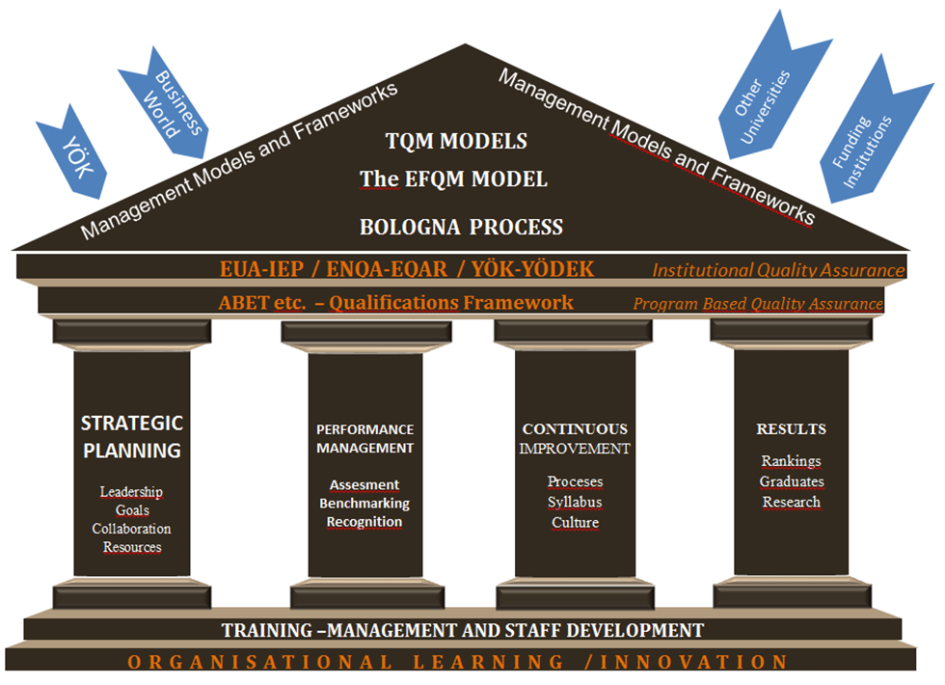
4. The Quality Initiatives Framework
Notes:
9

Slide 10

5a. The Research
Part of a larger ongoing research, showing initial results…
Analyzing the effectiveness of quality related initiatives undertaken by Turkish Universities.
Roadmap showing problematic areas and most effective tools
Notes:
10

Slide 11
5b. Analysis of University Strategic Plans
A content Analysis of strategic plans (30 Turkish Public Universities)
Sampling: 10 from top of list, 10 from bottom of the list and 10 from the middle of the URAP* rankings
Assumption: Strategies should differ
Examination through cluster analysis
Case study: Strategic Planning Process of a Turkish University (observations of 1 year)
URAP : A University ranking system developed by METU for global and national rankings
Notes:
11

Slide 12

6a. Key Findings
The results of cluster analysis indicated that the content of the strategic plans of the chosen universities shows no significant difference
Strategic Planning has no effect on the performance of the individual universities
Notes:
12

Slide 13
6b. Reflections from the Case Study
There is no internal motivation since the strategic planning is an initiative forced upon the institution.
Lack of managerial awareness of the importance of strategic planning
Long term planning is a weak side of public institutions.
University does not have a full managerial and financial autonomy; most strategies are affected directly or indirectly by the higher level authorities.
Therefore, strategic plans either contain operational elements only or produced just to comply with regulations.
Prospects: Hopeful to sincerely internalize
URAP : A University ranking system developed by METU for global and national rankings
Notes:
13

Slide 14
7. Conclusion
(Formal) Strategic Planning is a new tool for Turkish Universities
The QA process is largely in the hands of YÖK
There is an agency (Quality Council) in Turkey for QA in HE but not fully autonomous.
Bologna Process despite its ministerial level of presentation, still merely consist of basic QA procedures.
(Turkish) Universities need a collective wisdom of QM not just ad hoc quality initiatives.
Prospect: QA is a Management Philosophy
Notes:
14

Slide 15


        Thank You

